Slide 1
Welcome to Reception!
St Andrew
Miss Hall
Miss Harle & Miss Josling

Slide 2
EYFS Early Years Foundation Stage
We follow the EYFS and Development Matters – a continuation of skills from Nursey/preschool.

Slide 3
Year R Curriculum (Map can be found on the school website)
We learn through play and exploration.

Slide 4
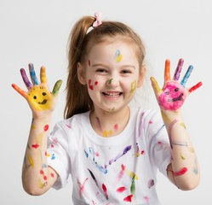
Please excuse the mess, we are learning!
This splodge is part of my lunch. I am trying to use a knife and fork correctly to cut my own food.
This mark was made with a pen. I am trying so hard to develop my drawing and writing skills!
This muddy mark shows that I have been moving around in different ways to develop my motor skills.
I got a bit wet today whilst exploring the water tray.

Slide 5
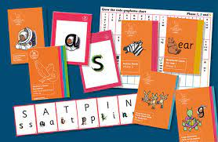
Literacy: Writing
Our writing will be linked to our daily Phonics (see overview). We will use our Phonics knowledge to:
Form all taught graphemes accurately,
Write our names and other basic labels and captions,
Create simple instructions,
Retell traditional tales (orally and with basic captions),
Write simple letters.
In all our daily communications, the children are encouraged to ‘THINK a sentence, SAY a sentence, WRITE a sentence’.

Slide 6
Literacy: Reading
Reading is also linked to our Phonics. Books should be phonetically decodable – repetition is key to fluency!
We complete 3 Group Reading sessions per week. Each session has a different focus.
On a Friday reading books will be sent home. These need to be returned the following Wednesday.
Please record all reading at home in Reading Diaries – a new page for each week – reading at least 5x per week. Little and often works best ☺
We visit the Library every Thursday.

Slide 7
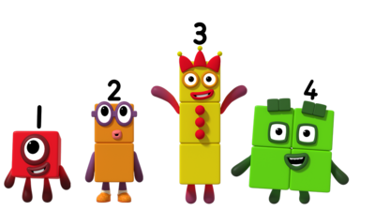
Maths Numberblocks
As a school, we follow the White Rose scheme for Maths.
In Reception, we do daily ‘Calendar Maths’.
We will use stories, songs, daily counting and lots of concrete resources to gain a deep understanding of numbers and what they are worth.
This term our units are:
Match, sort and compare: Matching objects and pictures and exploring sorting techniques.
Talk about measure and patterns: Comparing mass and capacity, exploring simple patterns.
It’s Me 1, 2, 3! Counting with one to one correspondence and subitising

Slide 8
Maths Numberblocks
White Rose have a fantastic FREE app!

Slide 9
RE
Our units of work this term:
Saint Andrew (Feast Day celebration 30th November), Discipleship, the school’s Mission Statement.
Creation
Catholic Social Teaching
Advent
In everyday, in all that we do, we aspire to be FAITHFUL.

Slide 10
Our Themes
Lots of our learning is themed around the children’s interests. Some of the themes we will cover are:
Marvellous Me! Learning about ourselves as we grow and change and sharing information about our families.
People Who Help Us: Finding out all about people in our communities who help us in lots of different ways.
Festivals & Celebrations: Including Diwali, Guy Fawkes Night, Advent and Chinese New Year.
We will also complete weekly PSHE/RHE lessons focusing on our uniqueness and friendships.

Slide 11
Homework How can you help at home?
Homework is set on Friday and is due in on the following Wednesday.
Reading and Phonics will always form a part of Homework.
https://www.littlewandlelettersandsounds.org.uk/resources/for-parents/
Other tasks may include: Basic Reading or Writing activities, Maths tasks linked to what we have done at school, or topic based research projects.
Some of this Homework will be set on Education City. Passwords will be stuck in Homework Books. There are lots of games to explore and play too!

Slide 12
Important Information
Monday & Wednesday: Come in to school in PE kit (Joggers on top of shorts to stay warm).
Thursday: Library visit.
Friday: Music with Mrs Bolam. Reading diaries and Home School Books checked.
Named water bottles and book bags (there is no need for a bigger bag in Year R!) in school every day.
Snacks/milk are provided.
Please ensure all uniform is named too.

Slide 13
Any Questions?
Please send your child to school as much as possible. We will always call you if they are unwell.
Feel free to ask any questions at drop off/pick up.
Send a note in blue book – send in your child’s hand.
Appointments available through the School Office.
Please let the Office know if someone other than you is collecting your child – we cannot release them without your consent.

